Slide 1
April 15th, 2026
Introduction to WorldShare ® Interlibrary Loan
Get Started
Sarah Robledo
OCLC Member Education
Notes:
Caption: https://www.streamtext.net/player?event=OCLC
Hi everybody, we will start the session in few minutes. Please, click on the check mark on the participant panel if you can hear me well and see the slide I’m sharing with the title of this session. If you have any issues with the audio, please write it on the chat and check your volume first or try to connect with the audio again. The same if you cannot see the slide I’m sharing (copy and paste this sentence to the chat)
I’ll open for questions after each segment but feel free to type your questions in the chat as we go and send to all participants/all attendees so everybody can see it. And if for any reason you cannot hear me or see what I’m displaying, please, write it on the chat. The handouts of the session are available if you click on File>Transfer>select the file> download. This session will be recorded, and I’ll send you the link to the recording via email after the session along with the handouts.
Start recording. Hello I'm Lucia Shelton and welcome to our session: Introduction to WorldShare Interlibrary Loan!
Explain the green check mark, red x mark, smile face (on Participant panel).
[CLICK to next slide]

Slide 2
Introduction to WorldShare ILL
Introduction to WSILL – Get Started
Introduction to WSILL – Prepare and plan
Register
Receive Community Center badge for attending training
Complete this form: oc.lc/training-badge-request

Slide 3

In this course you will learn about…
The basics of WorldShare ILL
Navigate and create staff accounts
Search options
Overview of creating ILL requests
WSILL tutorial videos:
https://oc.lc/WSILLvideos
Documentation & Support

Slide 4
1- Basics of worldShare ILL
Notes:
Let’s take a look at how OCLC ILL works

Slide 5
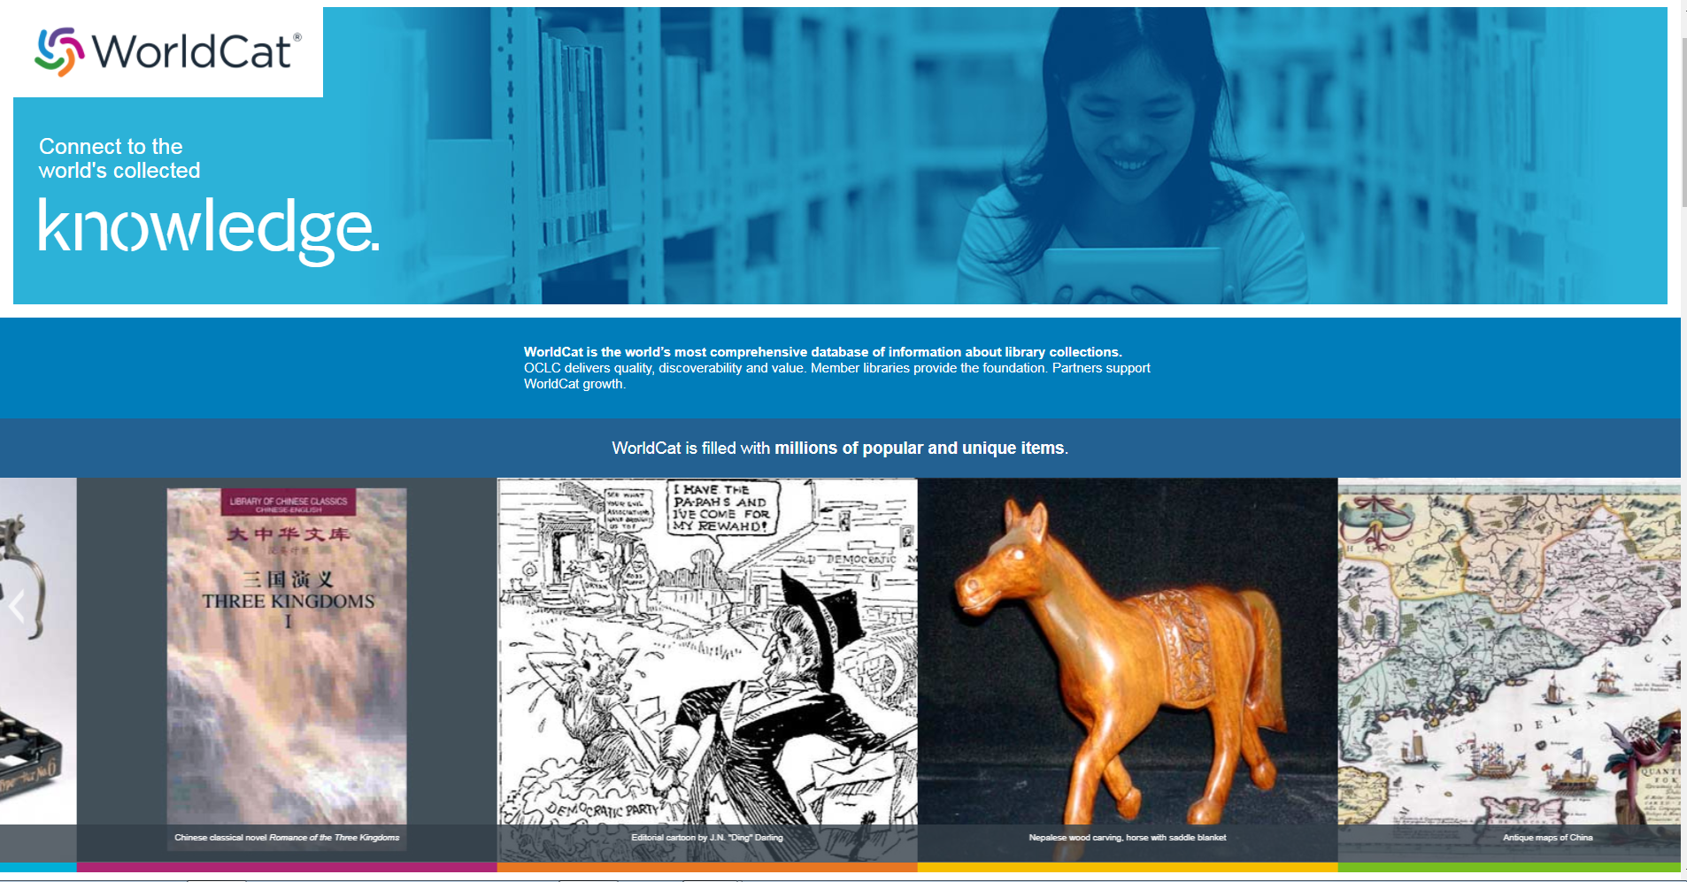
Built around the WorldCat database
Over 500 million bibliographic records with over 3 billion holdings.
Members fill an ILL request every second.
Notes:
OCLC is a library cooperative and most of the services, including WSILL, are built around WorldCat. WorldCat is the largest library catalog in the world with a diversity of formats in its content contributed by libraries around the world. And for Interlibrary loan purposes this is very good.

Slide 6
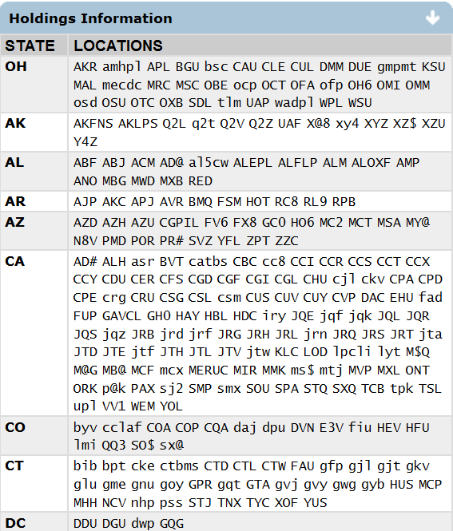
The library’s OCLC symbol
Holdings information in WorldCat became available for Interlibrary Loan purposes
Notes:
In the past, when a library would order catalog cards, what OCLC would do is attach a copy of the library’s code or symbol to the master record for an item. That way, not only would WorldCat serve as a source for metadata records, it would also itself be a record of who owned what items.
[Click]The screenshot on the right is a display of Holdings information for an item, from the Connexion cataloging software OCLC offers to libraries. Those 3-character or 5-character codes are the symbols for each library that owns an item.
As you can imagine, this record of ownership, or Holdings information as it is now known, has since become very valuable for ILL purposes.
In Oct 2015 OCLC discontinued the catalog card production.

Slide 7
Some WSILL Terminologies
Borrowing Library – requesting items in the service
Lending Library – supplying items in the service
Lender string – list of prospect lenders for the ILL request
Loan – ILL requests for physical items (i.e., books, DVDs)
Copy – ILL requests for copy of items (i.e., articles or book chapters)
OCLC Supplier – to define if a lender or not in the system
Days to Respond – how long a request stays with lender
Deflections – policy for system to automatically respond No
OCLC Groups – groups created by OCLC on behalf of libraries
Fulfillment – item supplied by lender
See OCLC ILL glossary of terms

Slide 8
How does it work?
How is a request submitted electronically in WorldShare ILL by staff?
  Search WorldCat for Item – Discover Items
  Choose your lenders from libraries with holdings
  Send Request
  Receive Item
  Return Item
Discover Items
Choose Lenders
Send Request
Receive Item
Return Item
Notes:
So, how does the service work? To put it simply, when a borrowing library goes to WorldShare ILL to request an ILL item, these 5 things happen:
[Click] The borrowing library will search WorldCat for an item;
[CLICK]
Choose the lenders they want to request the item from;
[CLICK]
Send the request;
[CLICK]
And then manage the request- mark it as received when it arrives,
[CLICK]
And mark it as returned when their patron is done with the material and the library can then return it to the lender. The electronic system pretty much becomes your tracking system for requests, and you can make all sorts of manual updates to the statuses of requests once they’re in the system.

Slide 9
Borrower Request Workflow
Lender String is list of potential lenders you select for an item
Up to 15 lenders at a time.
System automatically moves request to next lender.
The more lenders in the string the better the chance for request fulfillment.
Options for automation of lender string.
Notes:
When you choose lenders for your request, you can select up to 15 libraries at a time to request from in WorldShare ILL.
The way it works is that each lender has as default 4 days to respond to the item. And the system can automatically advance the request to the next lender if a lender doesn’t’ respond or says no to a request.

Slide 10
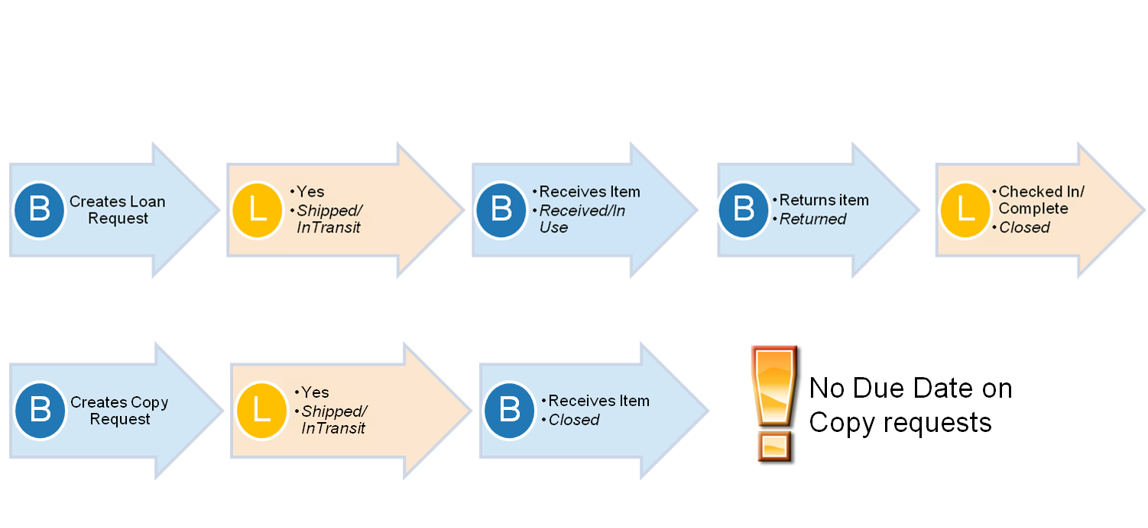
Request type determines workflow
Type also determines completion (B=Borrower or L=Lender)
Loan Request
Copy Request
Notes:
The request type determines the workflow of a request through the system.
[Click]Loan requests are closed by the Lender when the Lender receives the physical material back, such as a book or DVD, etc.
[Click]Copy requests are initiated and completed or closed by the requesting or Borrowing library, because there’s no material to return – it’s an electronic file or a paper copy of a material.
This workflow illustrates the importance of having the correct request type (copy or loan) associated with the request.
Open this file:
Getting Started with OCLC WorldShare® Interlibrary Loan [PDF]
Information on getting started with OCLC WorldShare® Interlibrary Loan (pg 15-17)
This document shows the statuses (categories) and next actions for Borrowers and Lenders.
Any questions? Is it clear the difference between a loan request and a copy request?

Slide 11


IFM – Interlibrary Loan Fee Management
Automates the billing of ILL transactions using the libraries OCLC account. Both libraries must accept IFM.
Borrowing Library
Lending Library
-$10
(Debit)
IFM
+$10 (Credit)
Notes:
IFM automates the billing for these transactions, using OCLC accounts of the two libraries involved in the transaction to track the exchange.
IFM is used by both Borrowing and Lending libraries in WorldShare ILL. If a fee is charged for an ILL request, money has to change hands between the two libraries involved in the transaction.
IFM credits the OCLC account of the Lending library and debits the account of the Borrowing library, for the amount to be charged by the Lender filling the request.
This streamline the library workflow because of instead of sending or receiving small payments to or from several libraries and trying to keep up with everything, the libraries have only to manage their OCLC account and the loan reports. But both the Borrowing and Lending libraries must accept IFM for this option to work.

Slide 12
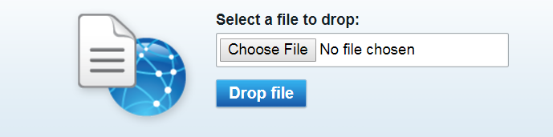
OCLC Article Exchange
Files no larger than 120 MB. Up to 1000 files a day per authorization.
Note: Document expires in 30 days or after viewed five times. Staff preview does not count.
Notes:
Let’s talk briefly about Article Exchange. The OCLC Article Exchange document-sharing site provides a single, secure location where lending libraries worldwide can place requested documents and library users can retrieve articles or book chapters obtained for them via interlibrary loan.
Note: Previewing document does Not count against the times document can be viewed.

Slide 13
2 - navigate & create accounts
Notes:
Let’s discuss some preparation tips to help you make most out of the WorldShare ILL service. If your library is new to WSILL the first thing you want to do is to check if your library information in the service is correct. If it’s not, then you might edit that otherwise you have to contact Customer Support to have that fixed.

Slide 14
Accessing WorldShare ILL –
New subscribers
WorldShare ILL is a subscription service
When your subscription process is complete, you will be sent a welcome email that includes:
Your library’s custom Web address for WorldShare ILL
Your WorldShare ILL Username (can be changed later)
Instructions for setting up your WorldShare ILL Password
A 9-digit Authorization Number and Password for Stats
Notes:
If your library is a brand new subscriber to ILL with OCLC, remember that once the process for setting up your subscription is complete, you will receive a welcome email that includes the following:
Your library’s custom Web address for WorldShare ILL
Your WorldShare ILL User Name (can be changed later)
Instructions for setting up your WorldShare ILL Password
A 9-digit Authorization Number and Password for Stats
Once you have this information, you are ready to use WorldShare ILL!

Slide 15
Accessing WorldShare ILL – new staff
If your library already has access to WorldShare ILL:
Consult with your colleagues; they may be able to give you your institution’s custom Web address. If not, OCLC Customer Support can provide it
A colleague with admin permissions can create a username for you
If a colleague creates a username for you, you will still have to create your password
Usernames can always be changed later on
Notes:
Alternatively, if you are simply a new staff member at a library with an established subscription:
Consult with your colleagues; they may be able to give you your institution’s custom Web address. If not, OCLC Customer Support can provide it
A colleague can create a User Name for you, or you can create one for yourself.
If a colleague creates a User Name for you, you will still have to create your password
User Names can always be changed later on

Slide 16
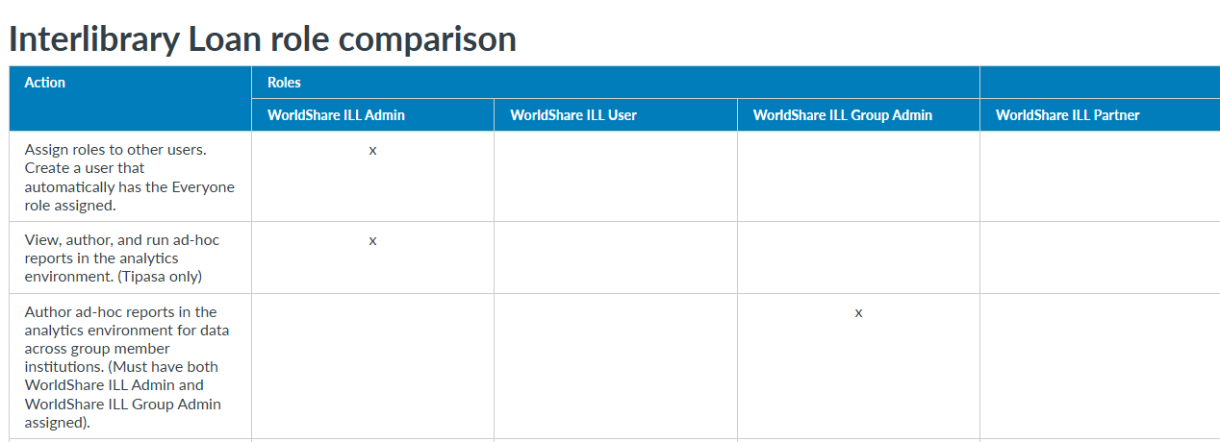
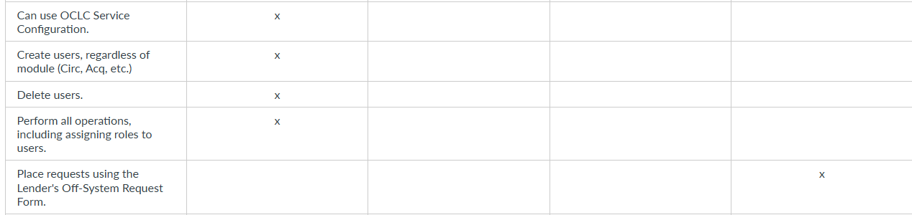
See Roles definitions

Slide 17
3. search options
Notes:
Let’s discuss some preparation tips to help you make most out of the WorldShare ILL service. If your library is new to WSILL the first thing you want to do is to check if your library information in the service is correct. If it’s not, then you might edit that otherwise you have to contact Customer Support to have that fixed.

Slide 18
Search options
Basic
Expert
Advanced
See Search options

Slide 19
4. Overview of
creating ILL requests

Slide 20
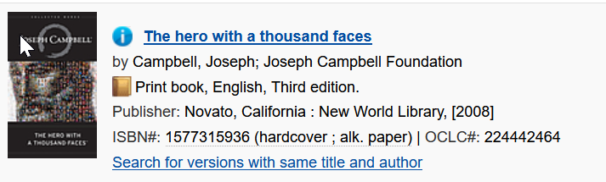
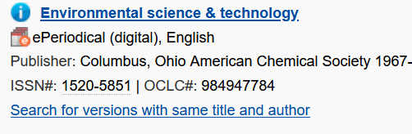
Loan request
(Physical item)
Article: Microplastic Accumulation in Freshwater Ecosystems: A 20-Year ReviewJournal: Environmental Science & TechnologyISSN: 0013-936X (print), 1520-5851 (online)Volume: 56 Issue: 12 Date: June 2022Pages: 8450–8465
Copy request
(electronic copy)

Slide 21
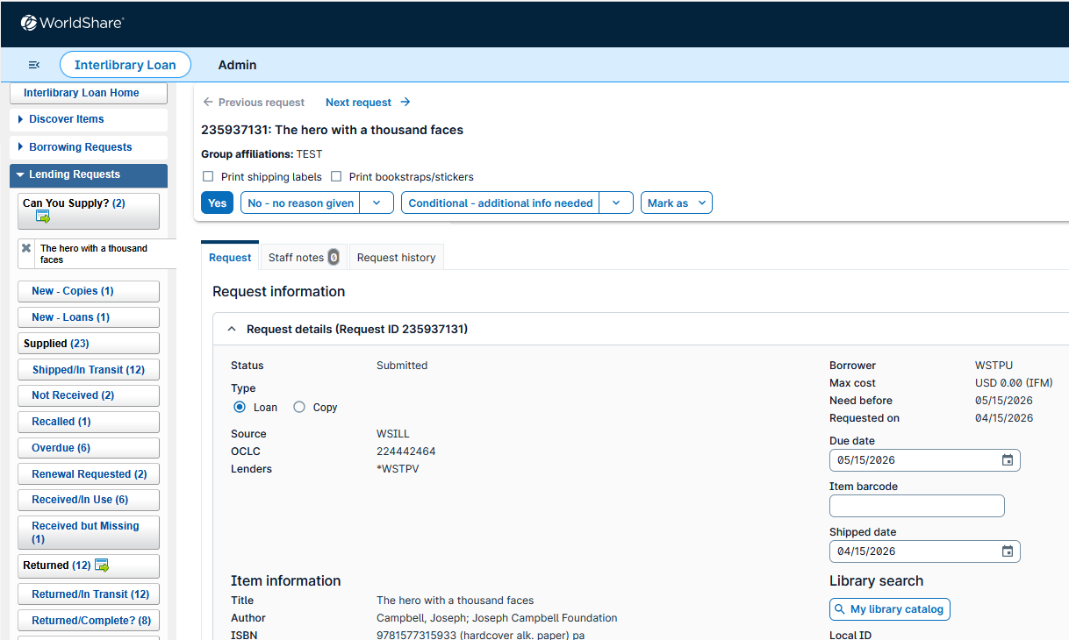
Lending library view of loan requests

Slide 22
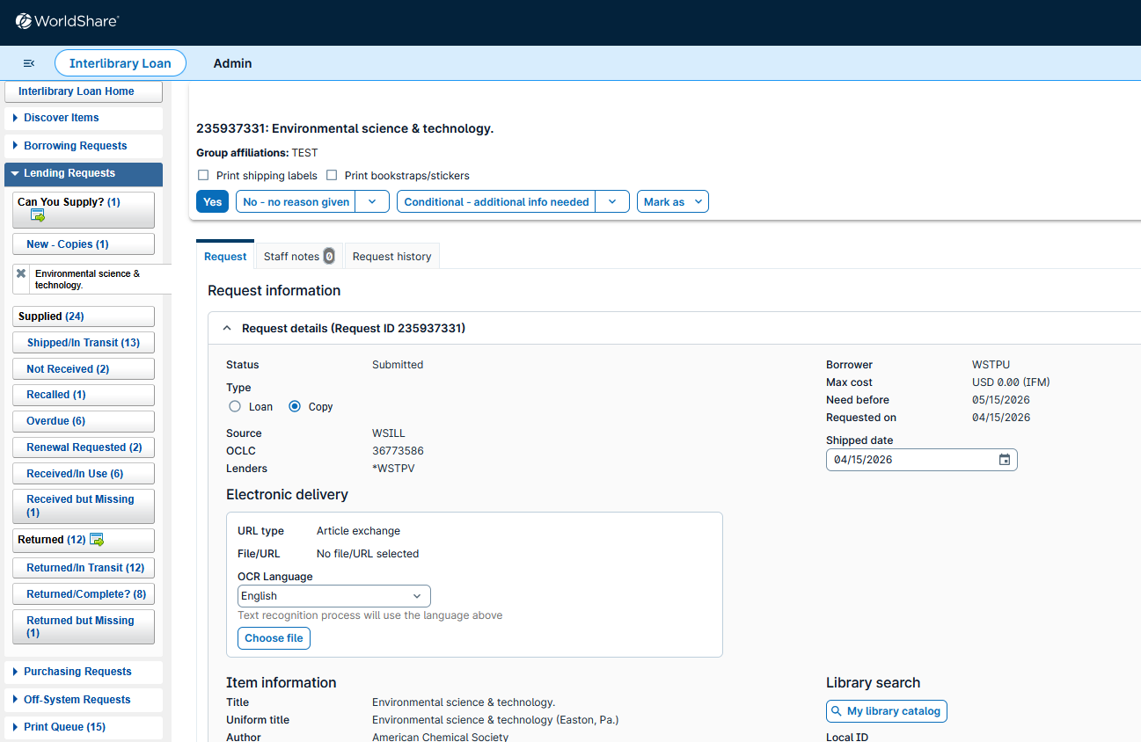
Lending library view of copy requests

Slide 23

Questions? Use the chat

Slide 24
Select the correct statement
The type of request (copy or loan) is not important.
Staff accounts are created by OCLC only.
The lender string can have up to 15 lenders.
You can access WSILL using any WSILL URL.

Slide 25
If I want to create a request for pages or chapters of a book in print, the type of the request to choose is:
Copy
Loan

Slide 26
Select the correct statement
Search options are to search WorldCat only.
I can combine up to 5 indexes in advanced search.
Advanced search never allows using part of the title.
Requesting multiple copies of same title is not allowed.

Slide 27

The four topics…
The basics of WorldShare ILL
Navigate and create staff accounts
Search options
Overview of creating ILL requests

Slide 28
Next steps
After completing Introduction WSILL courses
WSILL Borrowing
- Borrowing requests
- Manage ILL requests as Borrower
WSILL Lending
- Configuration for Lenders
- Manage and respond requests
Upcoming sessions - Register

Slide 29
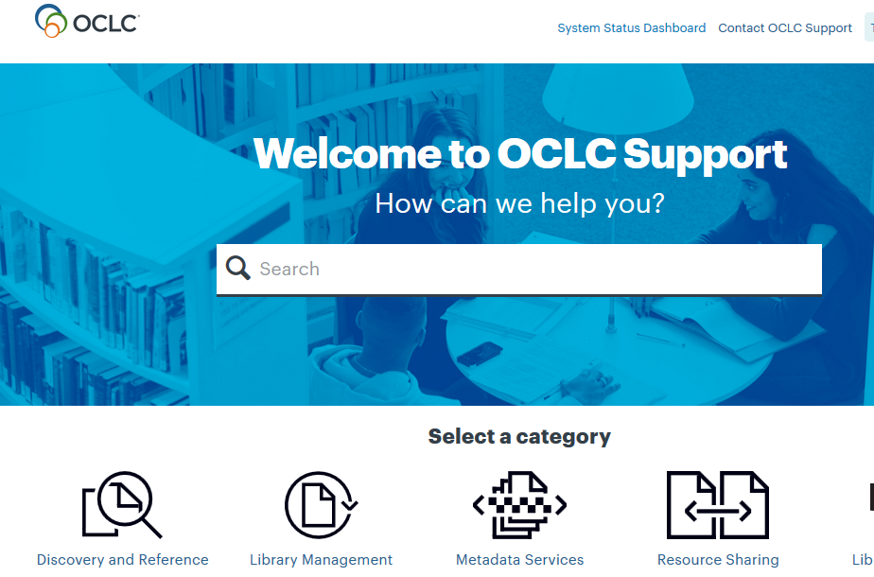
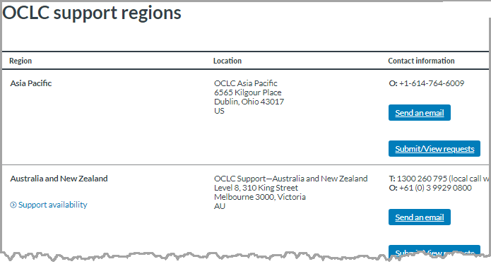
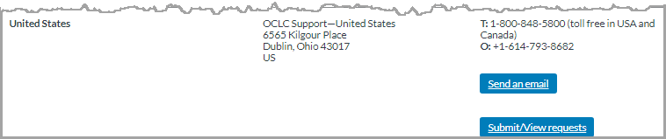
Support, Documentation & Tutorials
https://help.oclc.org
OCLC Support http://oc.lc/support
Subscribe to OCLC-SHARING-L listserv.
Notes:
If you need additional help, please visit https://help.oclc.org for documentation, training, and contact information for OCLC Support in your region. https://oc.lc/support-regions
Thanks for watching.

Slide 30
Thank You!
Please remember to fill out the evaluation for this class
Your input will help shape our future training sessions.
https://www.surveymonkey.com/r/IntroILLGetStarted
Date: 4/15/2026
Instructor: Sarah Robledo
Class name: Introduction to WorldShare ILL – Get Started
Training questions? Contact OCLC Training training@oclc.org/
Notes:
Thank you for your attendance and please fill out the evaluation form that will prompt on your screen as we end this session. The information regarding to this session that will need to enter on the form is on this slide. We value your feedback to help us improve our training materials and training sessions. For any training questions, please, contact us at training@oclc.org. Thanks again!

